Slide 1
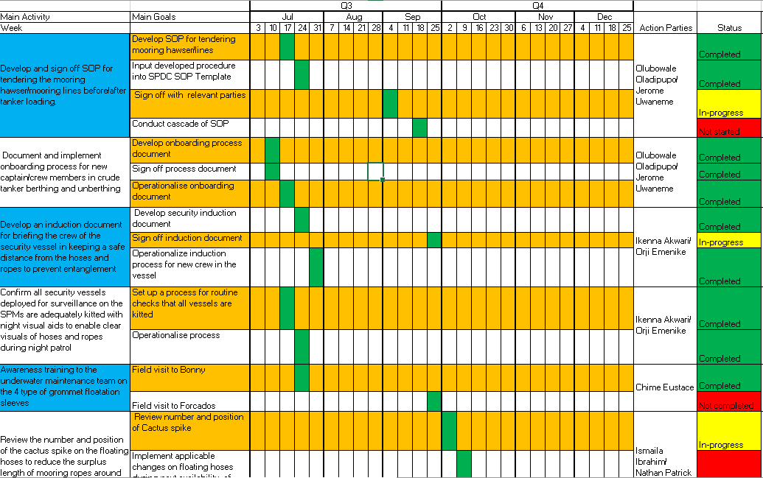
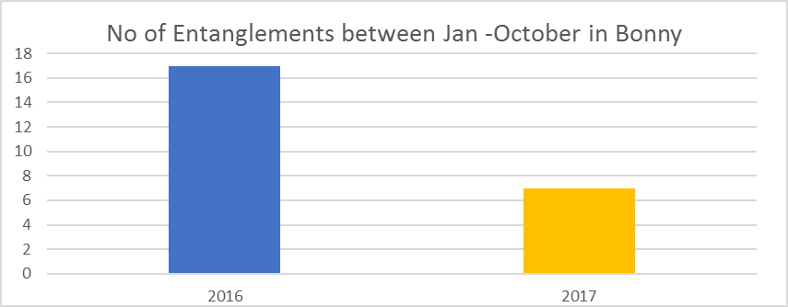
A3 Charter: Grommet Entanglement Reduction Initiative
Background
Proposed Countermeasure(s)
SEPCiN operates 6 SPMs and 1 tandem offloading System (TOS) comprising 1 unit in Bonga, 3 units in Bonny and 2 units in Forcados. EA operates the TOS. Each SPM has a pair of grommets for mooring offtake Tankers during loading operation. The TOS uses 1 mooring hawser. The mooring assembly at the end of every loading operation is let go on water to flow freely subjected to meteocean conditions. The ropes often get entangled with each other or wrapped around the SPM structure or the hose strings.
Identify root causes of grommet entanglement on Bonny SPM
Assess and prioritize causes/corrective actions to eliminate grommet entanglement
Implement corrective actions in Bonny and track effectiveness
Replicate actions in other assets and sustain practice
Plan
Current Conditions
In 2016, 17 entanglements occurred in Bonny offshore and 6 in Forcados offshore, 3 in Bonga. None in EA. Some of these entanglements often require mobilization of DSVs to free up at substantial cost and demurrage. One of such entanglements that occurred in Bonga in the recent years cost about $340,000 in addition to over $1mln loss of revenue as loading could not take place for 5 days. In addition, the SPM boat catcher was damaged. There is therefore need to identify all the factors/ processes surrounding the management of grommet ropes while in operation, and thereafter put in place a framework to address the issues and reduce/eliminate
Goal(s)
Goal is to reduce/ eliminate the number of entanglements using CI tools to identify the “bad actors” and eliminate them. This will increase equipment availability for crude export, cost avoidance, reduce demurrage and potential loss of revenue and production shut down. Bonny offshore will be used as a test case and replicated across SEPCiN
Team Members
Analysis
Chime, Eustace
Faniyi, Fasakin
Ibrahim, Ismaila
Uwaneme, Jerome
Akwari, Ikenna

